Slide 1
Data Visualisation FEIT 13 April 2021
Presented by Nathaniel Butterworth
Slides courtesy of Kayla Maloney
https://www.sydney.edu.au/research/facilities/sydney-informatics-hub.html

Slide 2
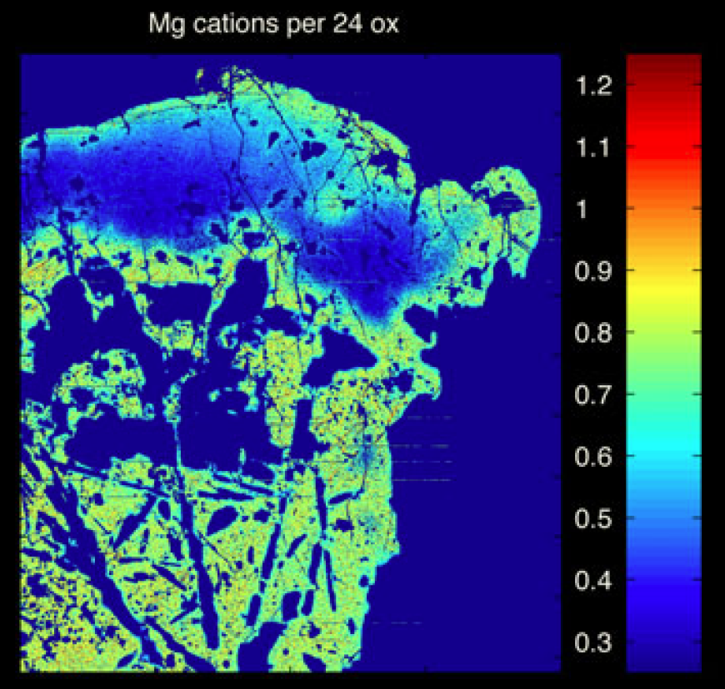
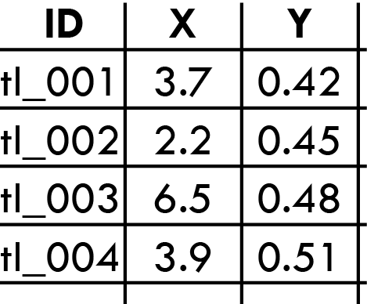
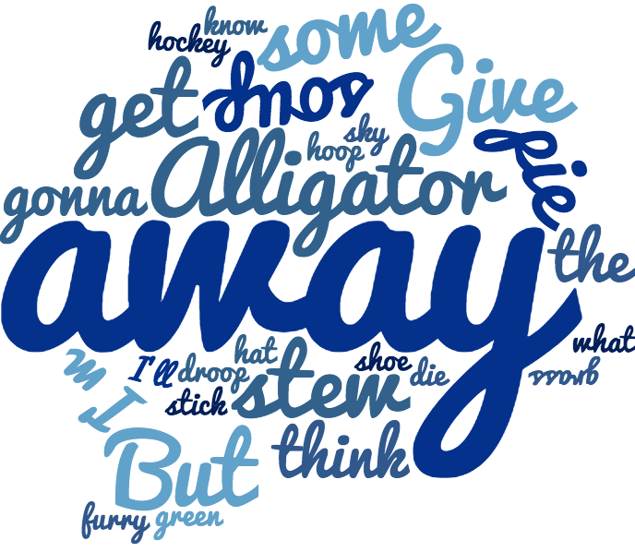
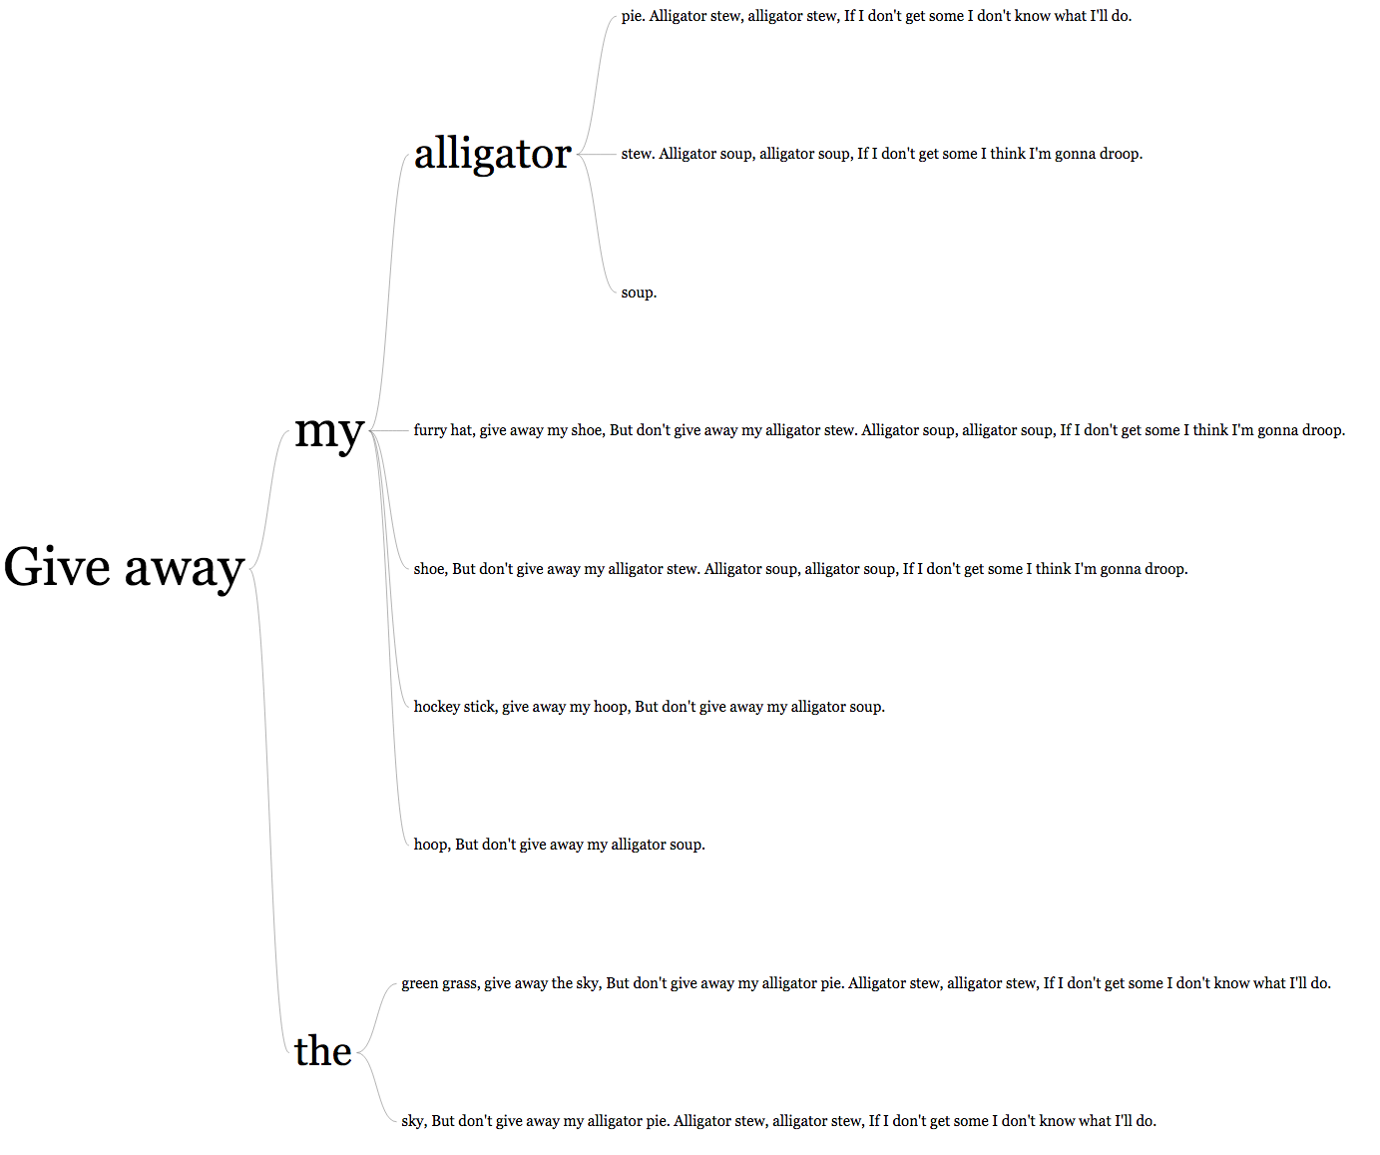
What is data visualisation?
Maloney et al. (2011)
doi:10.1111/j.1525-1314.2011.00934.x
Notes:
Convert data into a visually interpretable form in order to extract meaning that might not have been obvious in the original representation. Data can take many forms, and visualisation is a big bucket that comprises a lot of wide-ranging activities.

Slide 3



Who is it for?
Yourself
As part of the analysis of your data
Others in your field
At conferences or as figures in papers
Non-specialists
As part of public outreach
As part of reporting requirements
Notes:
Visualisations will change depending on who the intended viewers are.
Yourself – visualisations are to help you find the trends, relationships, etc. present in your data. The visualisations don’t have to be polished end products, but should be part of an easily repeatable and well documented workflow.
Others in your field – communicating your results to your fellow researchers. Make use of pre-existing knowledge in your audience by employing commonly used visualisation types or common conventions in your field.
Non-specialists – communicating your results to the general public. Don’t use specialist visualisation types or terms. Highlight the key points and messages of your visualisation; laypeople who aren’t used to the data and analyses that you have done might miss messages that are obvious to a specialist.

Slide 4
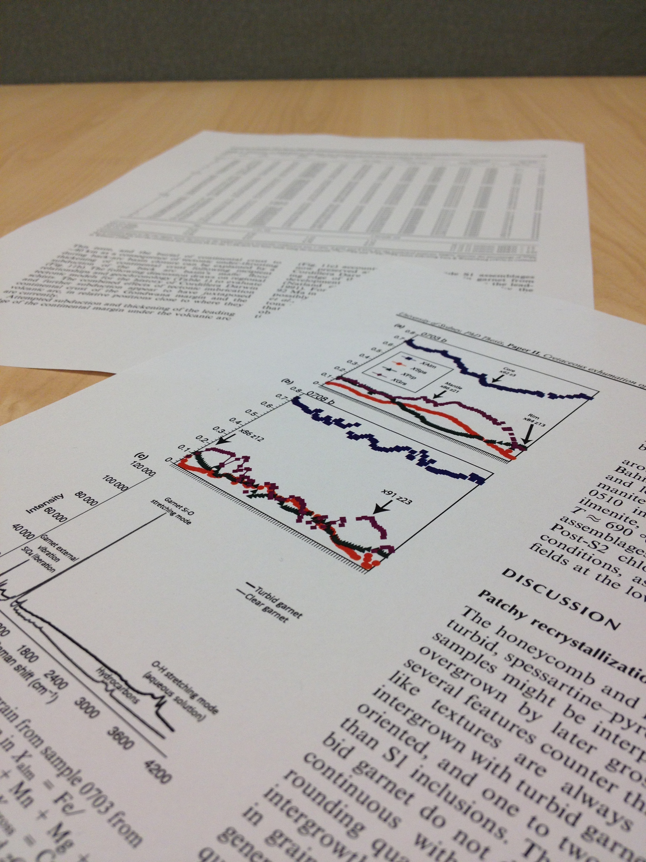
Presentation medium
How are you going to present your visualisation?
Figure or table in a paper or poster
Notes:
Although often overlooked, tables are a form of data visualisation. They are most useful for displaying small amounts of data for which the data values are important to the viewer.
Figures and tables in papers or printed on posters are static visualisations, so you will need to carefully choose the views of your data that are most appropriate, there isn’t an opportunity for users to manipulate or drill down into the visualisation in any way other than what you lay out in front of them. However, this also means that you know exactly what the viewer will see, so you have more control over exactly what message it is that you are communicating.

Slide 5
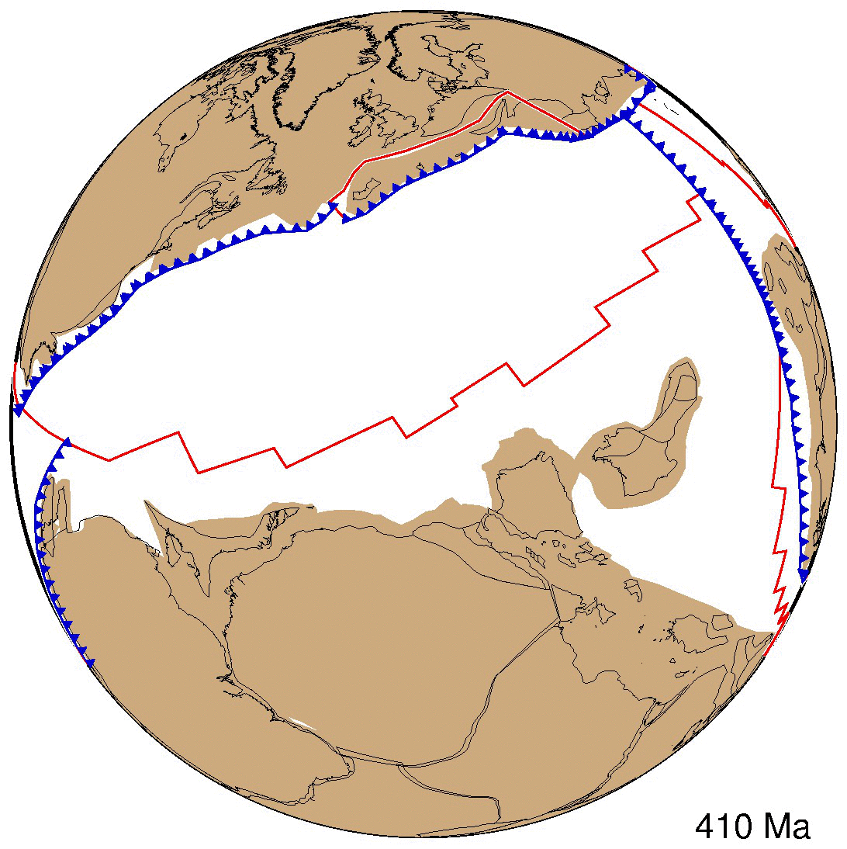
Presentation medium
How are you going to present your visualisation?
Figure or table in a paper or poster
On a slide in a talk
Notes:
Presentation format allows for animations or fly-throughs of 3D visualisations that you can talk your audience through. If you use an animation in a presentation, make sure that:
Your animation plays correctly on the equipment you will use when presenting
The frame rate is appropriate
You can pause and restart your animation to point out important details, or have your animation on a continuous loop if it is short enough (do NOT loop long animations)

Slide 6
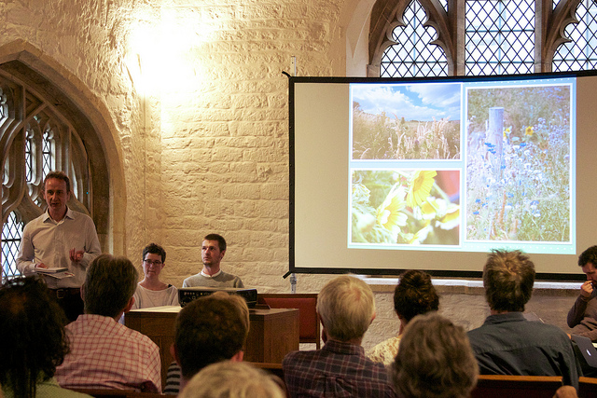
Presentation medium
How are you going to present your visualisation?
Figure or table in a paper or poster
On a slide in a talk
Presentation shared by Cultivate Oxford on flickr [CC BY-NC 2.0]
Notes:
Make sure everything on your slides is easy to see, even for people far away by:
Making the visualisation as large as possible
Reduce explanatory text – you will be there to talk people through the main points
Only one visualisation per slide, unless visualisations need to be compared
Use large, easy to read fonts and high contrast colours

Slide 7
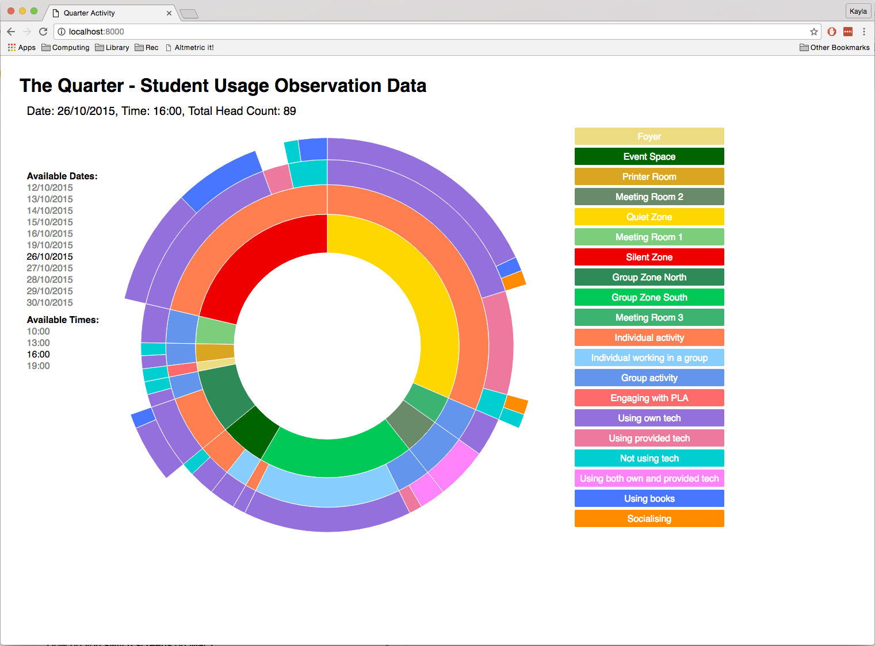
Presentation medium
How are you going to present your visualisation?
Figure or table in a paper or poster
On a slide in a talk
On a website
Notes:
Browser based visualisations allow interactive visualisations, as well as animations or static visualisations. Interactive visualisations allow users to engage with your data and investigate the aspects that interest them most, but they mean that you are no longer in control of what the users see, and depending on how they choose to interact with the visualisation, they may come away with an incomplete or misleading view of the data.

Slide 8

Principles of Data Visualisation
Focus on the primary message of the visualisation
Keep it as simple and uncluttered as possible
Provide all information necessary to understand the visualisation
Make comparisons easy
Avoid any misleading presentation
Notes:
Points that you can refer back to when creating or assessing visualisations to make sure they are as effective as possible.

Slide 9
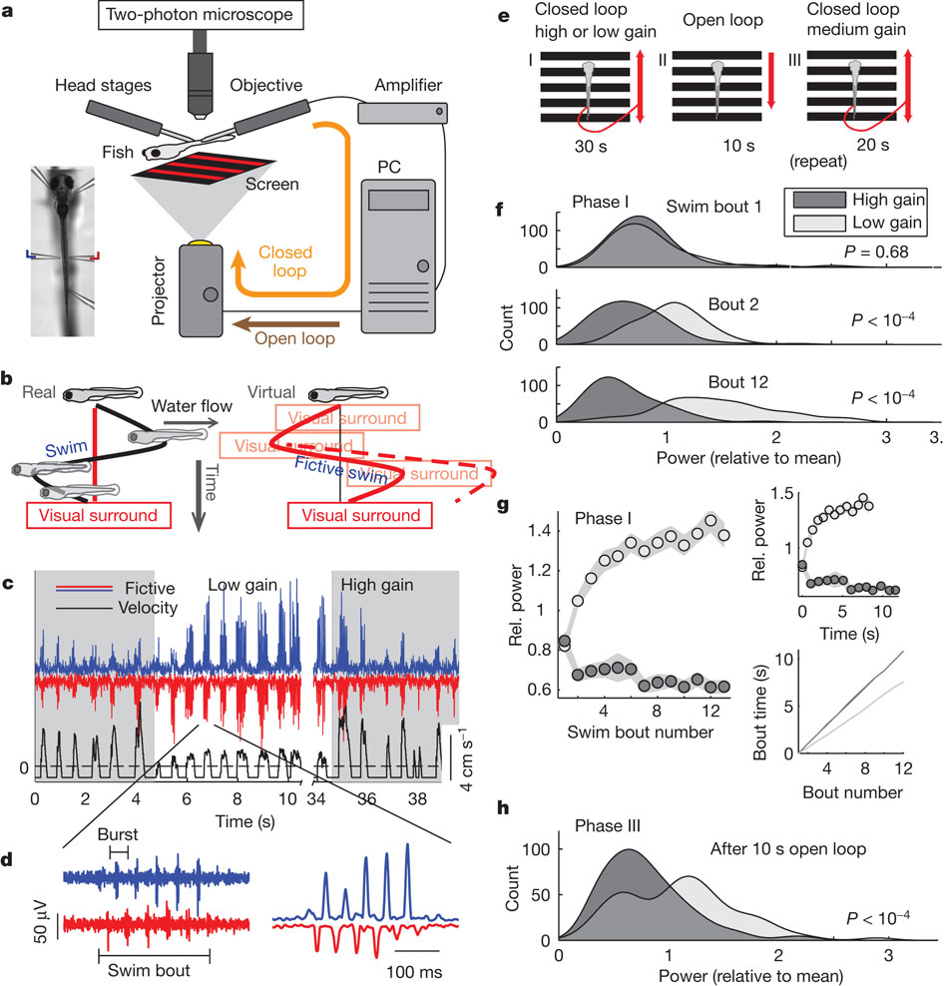
Focus on the primary message
Make sure you have a primary message!
Use multipanel figures when the visualisations are closely related, otherwise use separate figures
Consider using supplementary material
Ahrens et al. (2012)

Slide 10

Focus on the primary message
Pick a figure type appropriate to your data and your message
Numerical
Categorical
Hierarchical
Network
Geographic/geospatial
Textual
Notes:
These are just a few types of data and examples of visualisations that would be appropriate to them, but it is certainly not exhaustive – there are many forms of data and visualisations that you may encounter.

Slide 11
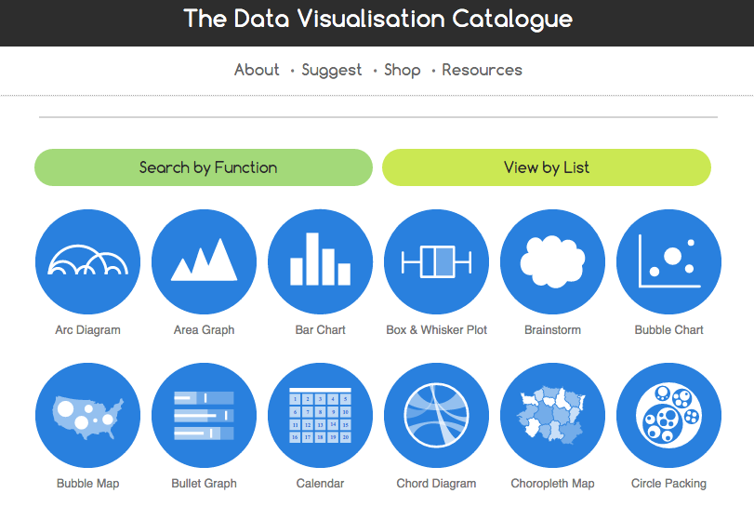
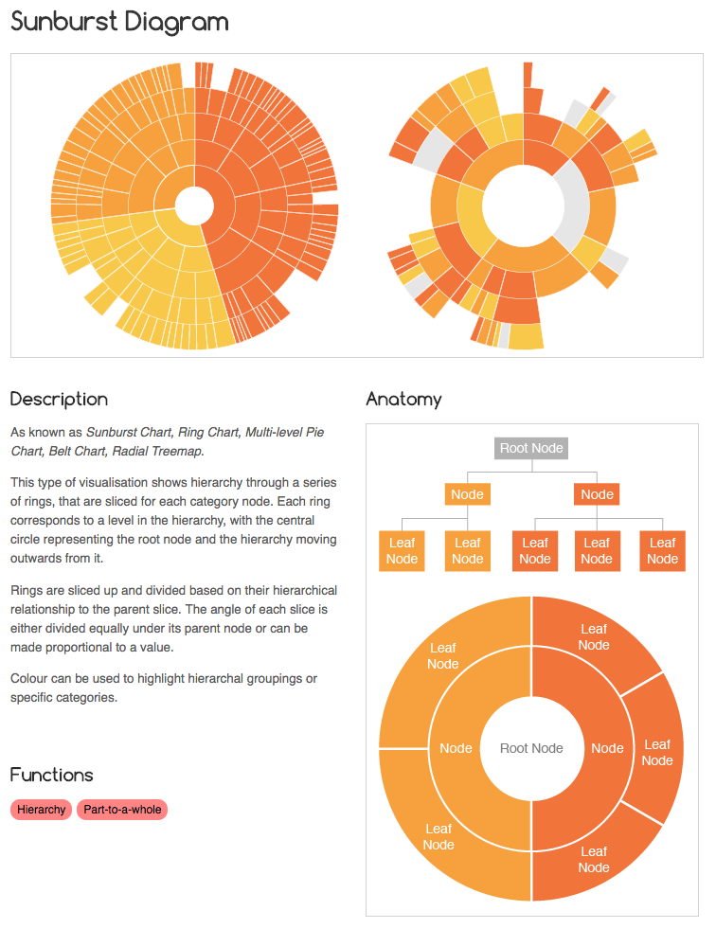
Focus on the primary message
Blah
The Data Visualisation Catalogue can be found at:
http://www.datavizcatalogue.com/
Or
https://datavizproject.com/
Notes:
The Data Visualisation Catalogue is a library of about 60 different kinds of data visualisations, created by Severino Ribecca. It’s a very useful resource for helping to find an appropriate visualisation type, and tools that can be used to create the visualisation.

Slide 12
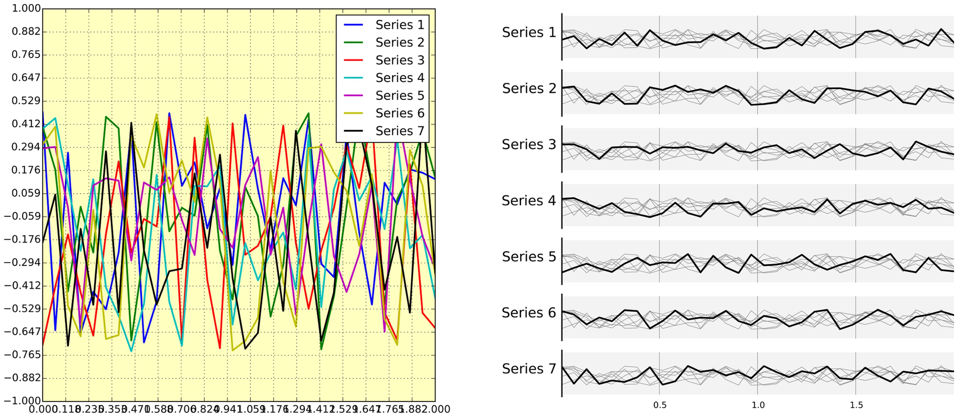
Keep it simple and uncluttered
What’s wrong with this graph?
Notes:
Visualisations can be cluttered or overcomplicated by:
- Overplotted data
- Excessive annotations
- Non-meaningful colour
- Poor layout

Slide 13
Keep it simple and uncluttered
Consider your message when simplifying and tidying.
Rougier et al. (2014) [CC0 1.0]
Notes:
How you go about tidying up figures can vary a lot depending on what you wish to communicate. In the example given, the new plots show the trends of the different series well, but it would be very difficult to get any exact values off of them. If that information was necessary, then a different method for reducing the overplotting would need to be used. Remember that the best figure is the one that does the best job of clearly conveying the information that you want it to show, so which graph is the “best” will depend on the purpose you have in mind for it.

Slide 14
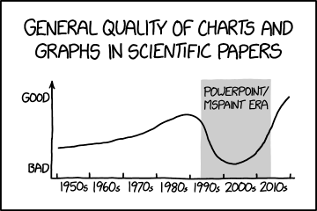
Keep it simple and uncluttered
Plotting program defaults
Scientific Paper Graph Quality by Randall Munroe xkcd.com [CC BY-NC 2.5]
Notes:
The software you use to create a visualisation will usually apply default plot and style parameters. These defaults are often inappropriate or non-optimal for your data.

Slide 15
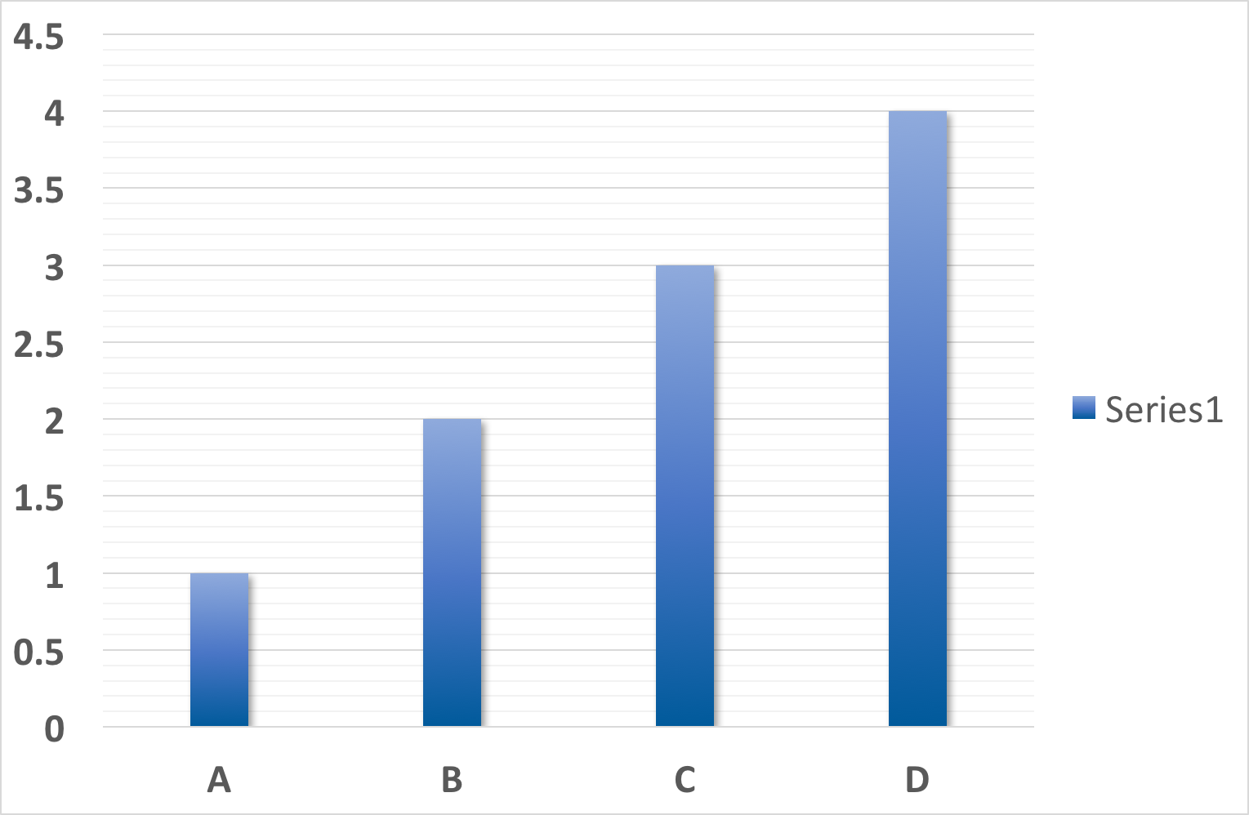
Keep it simple and uncluttered
Plotting program defaults
Gridlines, gradients, shadows, excessive annotations add clutter

Slide 16
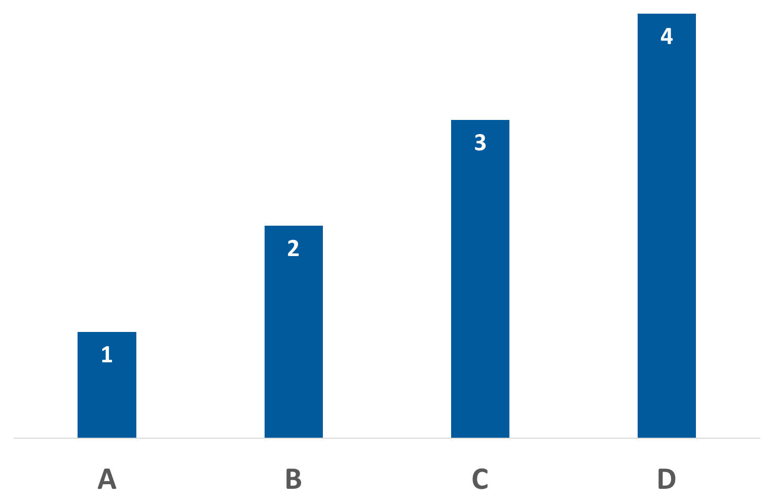
Keep it simple and uncluttered
Plotting program defaults
Gridlines, gradients, shadows, excessive annotations add clutter
Direct labelling useful for simple plots
Custom chart templates
Notes:
To save time, most tools allow you to create custom chart templates so that you choose the best parameters for your chart and then easily apply them to similar charts in the future.

Slide 17
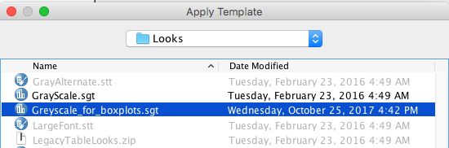
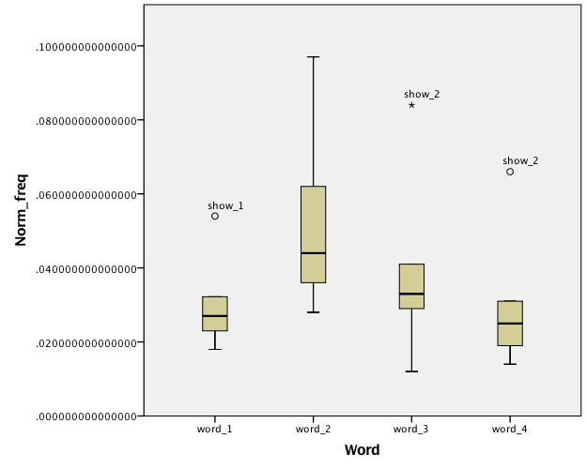
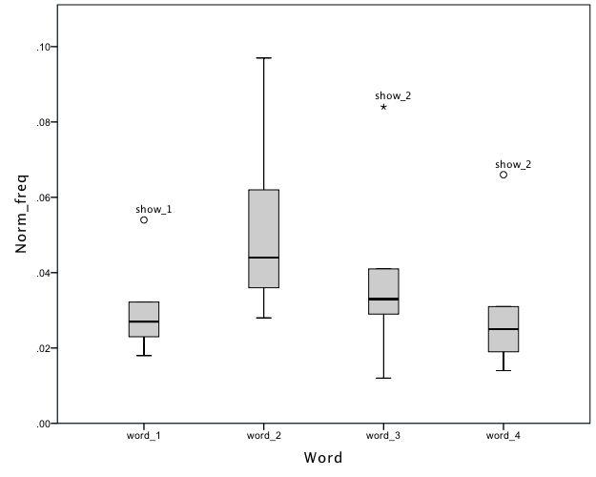
Keep it simple and uncluttered
Plotting program defaults
Custom chart templates
Notes:
To save time, most tools allow you to create custom chart templates so that you choose the best parameters for your chart and then easily apply them to similar charts in the future. The example shown is from SPSS, but Excel and most plotting tools have a similar feature.

Slide 18
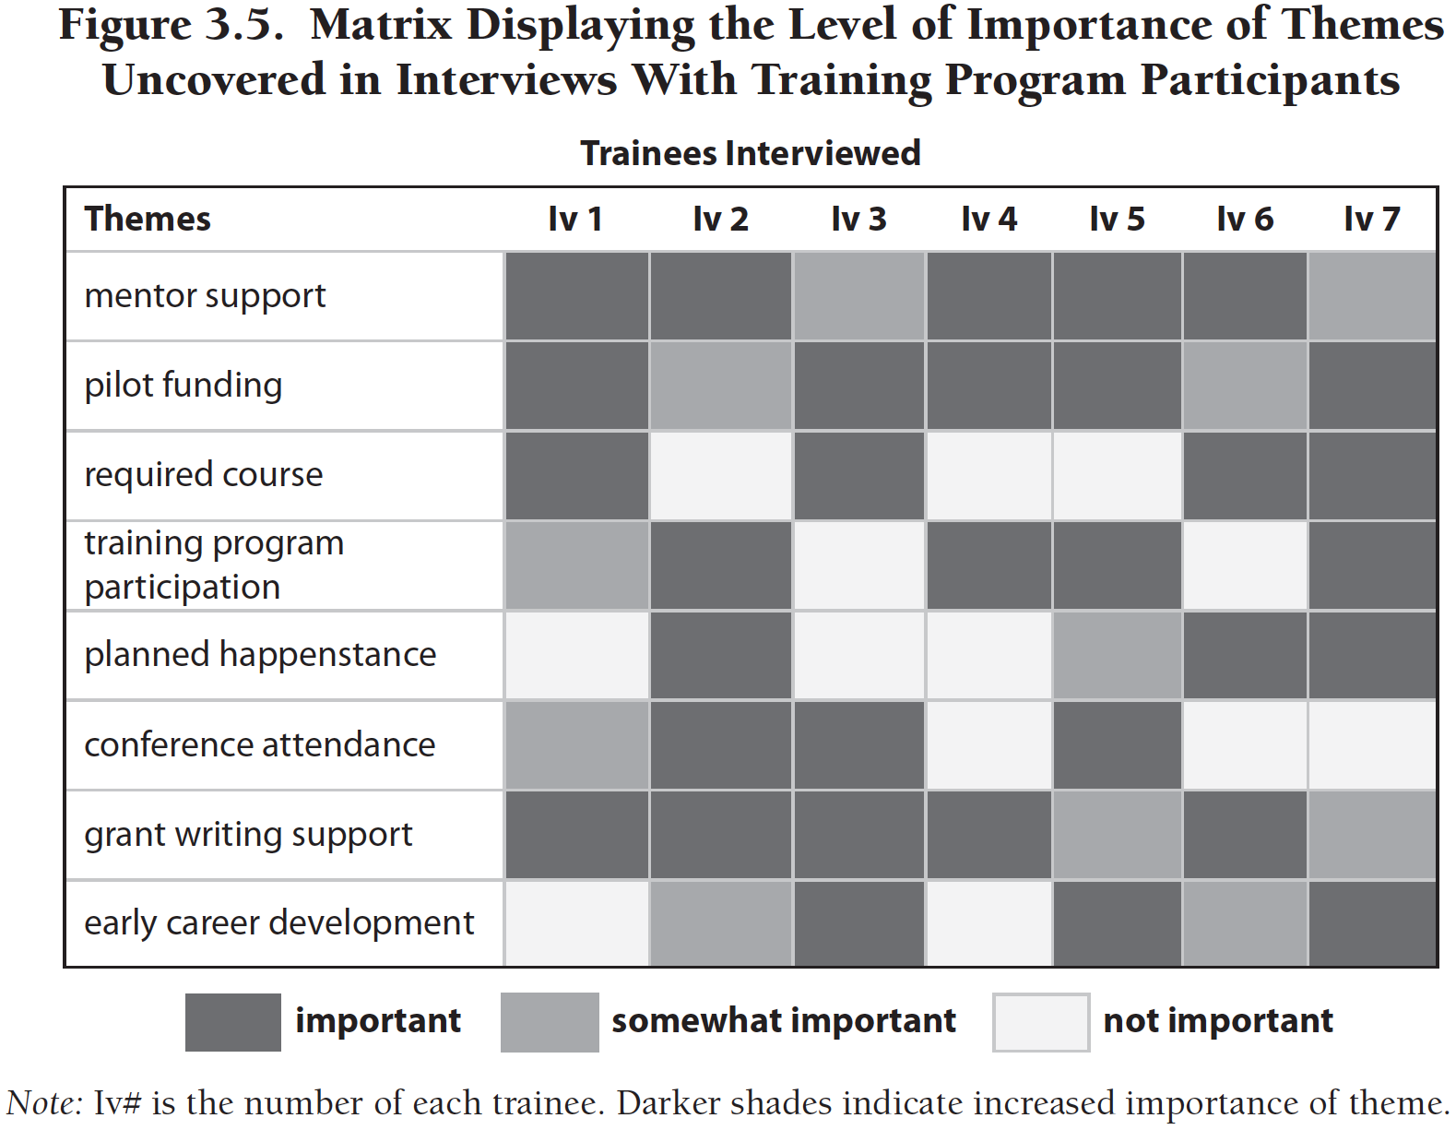
Include all necessary information
Make visualisations self-contained
Figure captions
Informative labels and/or title
Colours or symbols defined
Abbreviations or acronyms defined
Information on how to interpret visualisation provided if necessary
Henderson & Segal (2013)
Notes:
Make sure that all of the annotations, legends, definitions and descriptions that are necessary to understand the visual are included in it. Note that this doesn’t mean that everything needs to have the context around it provided; this context will usually be in the text of a paper or be what you talk about during a presentation. For a self-contained visualisation viewers need to be able to identify everything and understand how to interpret a visualisation using information within the visualisation, but they don’t necessarily need to be able to determine why it’s important or how it fits with other information – that would often be trying to make a visualisation too many things, and detract from your primary message.

Slide 19
Include all necessary information
Ensure all parts are easily legible
Informative and Legible Graph Title
8
Series 1 Name
Informative and Legible Graph Title
8
Series 1 Name
Series 2 Name
6
Series 2 Name
Legible Y-Axis Title
6
4
2
Legible Y-Axis Title
10
20
30
40
50
Legible X-Axis Title
4
2
10
20
30
40
50
Legible X-Axis Title
Keep font sizes large-ish
Choose symbols that are easy to discriminate between
Draft your visual at the final size

Slide 20
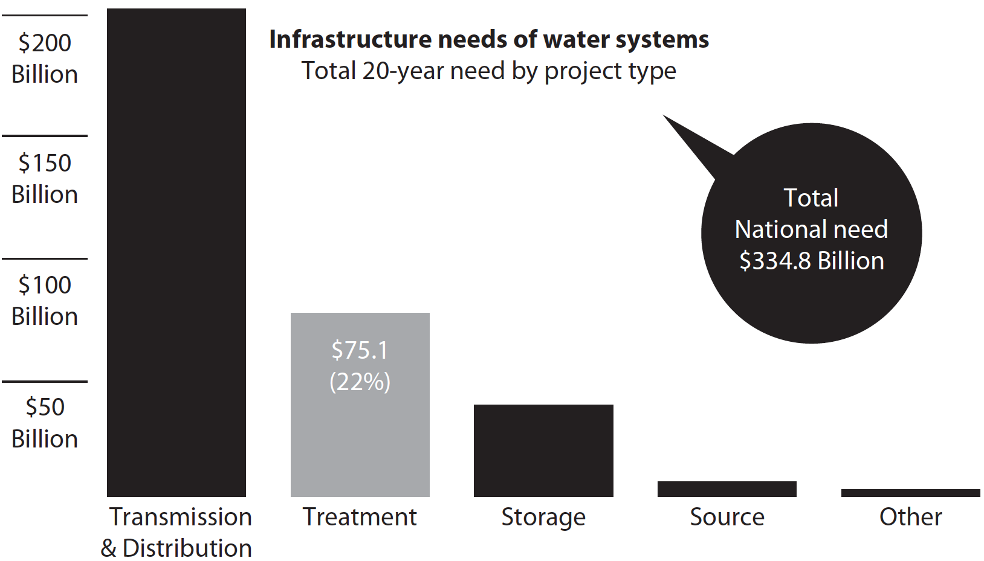
Include all necessary information
Emphasise important details
Use sparingly! You don’t want to re-clutter your visual
Evergreen & Metzner (2013)

Slide 21
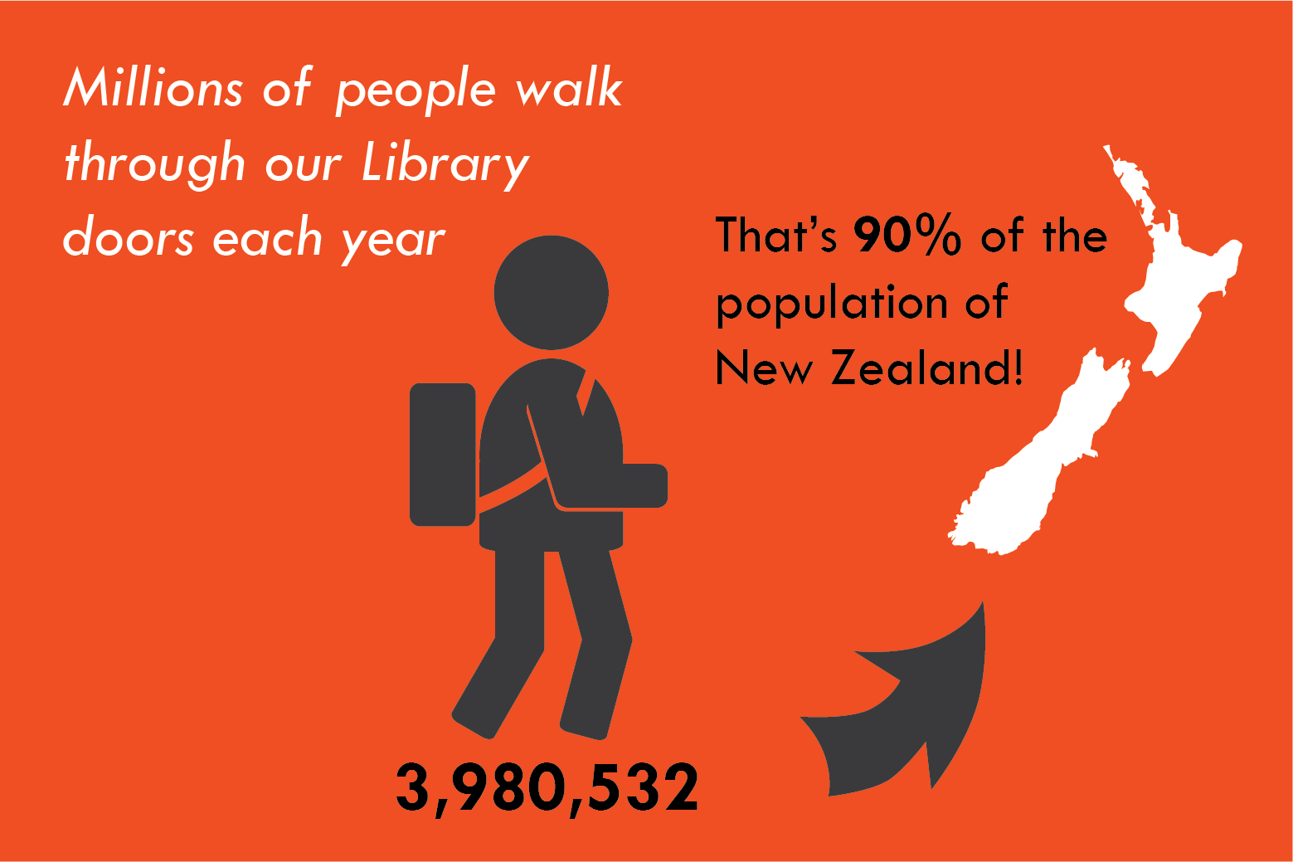
Include all necessary information
Emphasise important details
Infographic-style visuals can increase the impact of important points

Slide 22
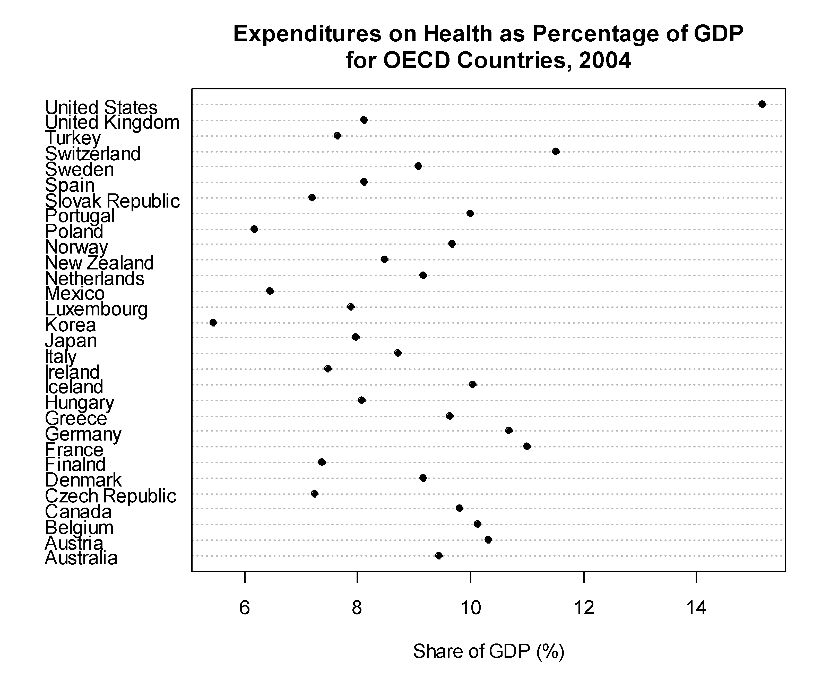
Make comparisons easy
Michael Friendly (2001)
[CC-BY-NC 3.0]

Slide 23
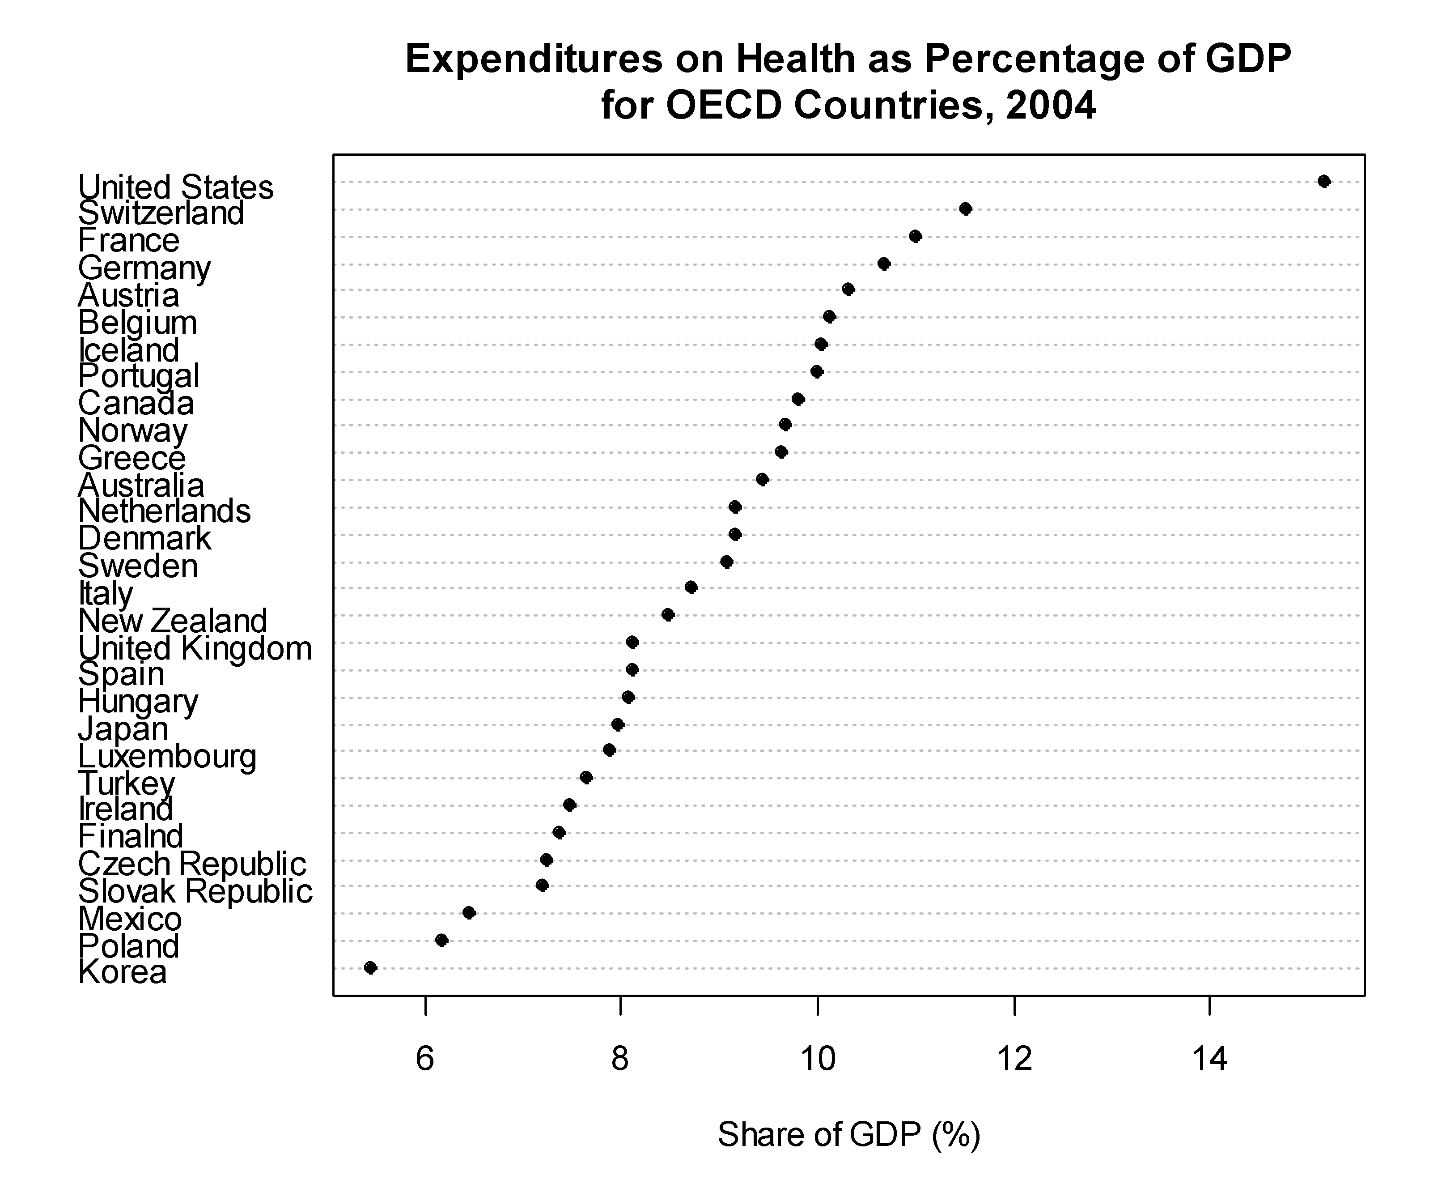
Make comparisons easy
Order data in a meaningful way
Michael Friendly (2001)
[CC-BY-NC 3.0]
Notes:
If there is an intrinsic order to your data, then you should use that – for instance time, age, severity would all be data with an inherent order. If your data are nominal, that is, they do not have an intrinsic order, then it can be useful to order your data by either ascending or descending value.

Slide 24
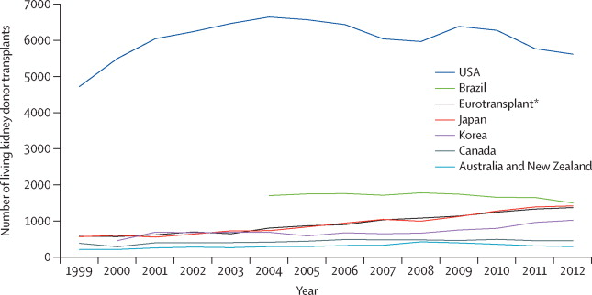
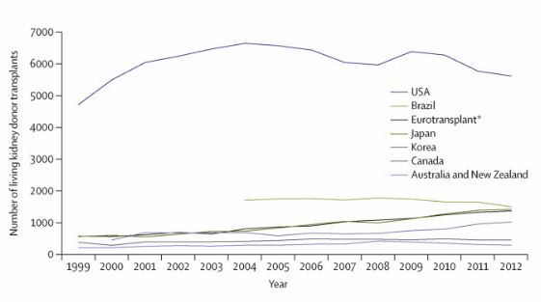
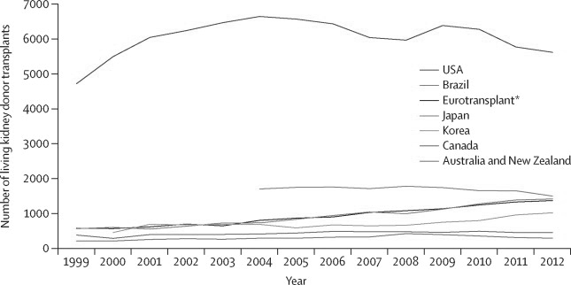
Make comparisons easy
Consider your use of colour:
Is it colour blind vision friendly?
Could it be reproduced in black and white?
Reese et al. (2015)
People with deuteranopia will perceive this…
Printing in black and white results in this…
Modified from Reese et al. (2015)
Notes:
Just under 10% of men, and a much smaller number of women, are affected by colour vision deficiency – you don’t want to make a figure that has been designed in such a way as to be meaningless to these people. It’s a good idea to ensure that colour is not the only means used to convey any piece of information on your figure, or that you have taken care to choose a colour palette that is colour-blindness friendly and can be reproduced in black and white.

Slide 25
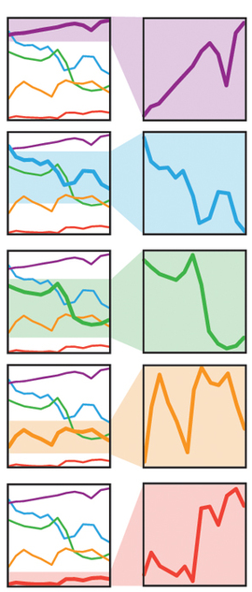
Avoid misleading presentation
McInerny & Krzywinski (2015)
Ensure your scale is appropriate
Different scales can wildly change how your data is perceived
Including zero shows the overall trend
Clipping the y-scale around the data highlights the actual data values and the variation within your data
**Always include zero on bar or area plots**
Notes:
Scale manipulation can be abused by people trying to push specific messages. Note that whenever a scale doesn’t start at zero, it increases the chance that someone won’t notice the labels, and will misinterpret the plot. That doesn’t mean that you can’t clip your scales for line or scatter plots, but you need to be aware of the potential for misinterpretation, and try and be as clear as possible with your labels. However, since bar and area plots connect the data point to the x-axis, they must always start at zero on the y-axis, or you will mislead your viewers.

Slide 26
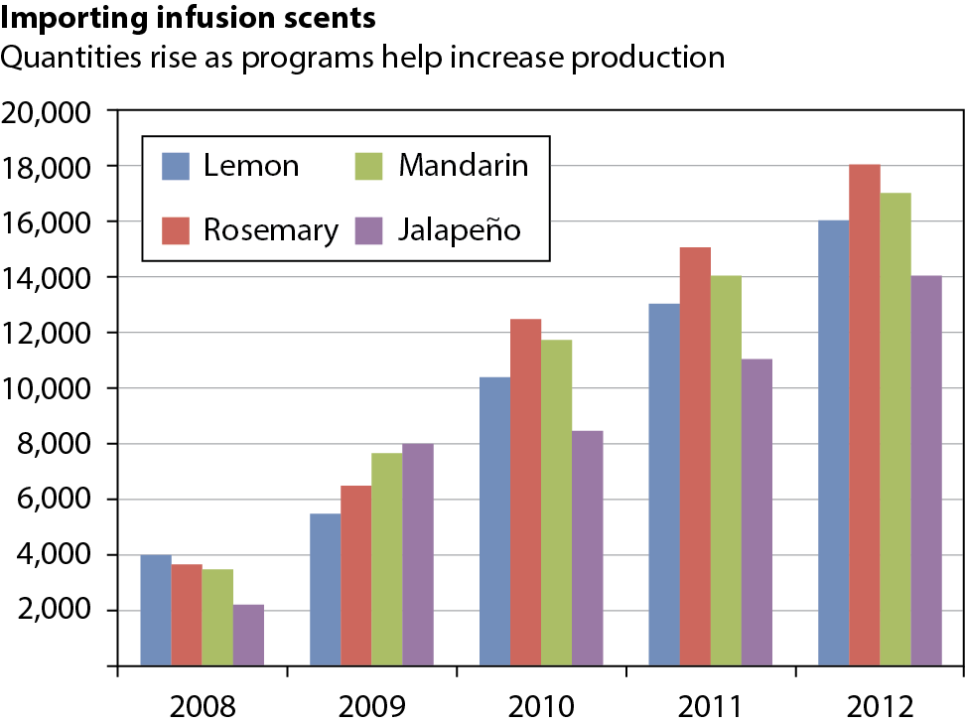
Avoid misleading presentation
Consider your use of colour:
Pre-existing colour associations
Evergreen & Metzner (2013)
Notes:
Using default settings on data visualisation programs can sometimes introduce sources of unexpected, or unnecessary confusion. In this example, the default colours that Excel provides have been used, and while they work okay to distinguish the categories here (this chart might cause problems for colour deficient vision or if it was reproduced in black and white) viewers will regularly have to look back at the legend to remember which colour represents each scent.

Slide 27
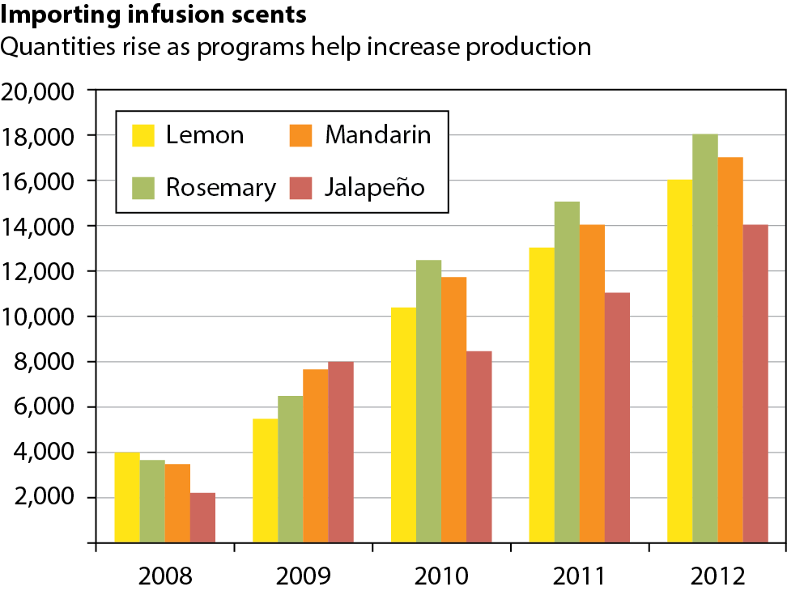
Avoid misleading presentation
Consider your use of colour:
Pre-existing colour associations
Recoloured from
Evergreen & Metzner (2013)
Notes:
Here we make use of the fact that people will associate the colour of the item in real life with the colours on the chart. Now after one look at the legend, viewers probably won’t need to look back at it again to know which colour column represents which scent. It is also worth thinking about other common associations like stop and go for red and green, or cold and hot for blue and red. If you do use a colour pairing or palette that has an association like those mentioned, make sure that the way you apply the colour makes sense with the association that people will have. Note that the example above would likely still be problematic for colour deficient vision or if reproduced in black and white.

Slide 28
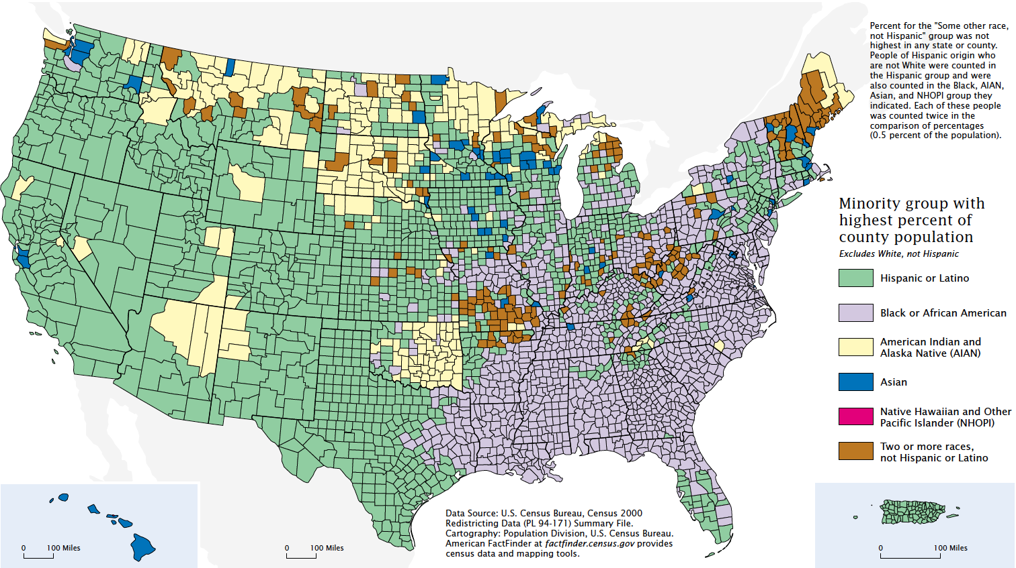
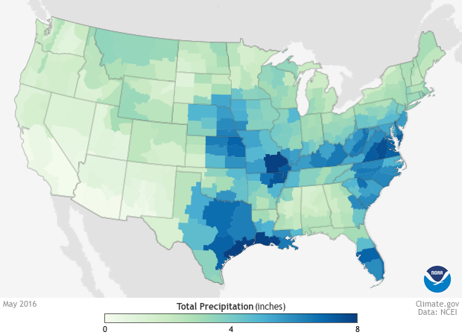
Avoid misleading presentation
Consider your use of colour:
Does it imply nominal or sequential data?
US Census Bureau, Census 2000
NOAA at climate.gov
Nominal
Unordered
Represented by different, distinct colours
Sequential
Ordered
Represent by a gradient, generally in hue or intensity
Notes:
Using a sequential colour scale for nominal data would imply an inherent order or ranking in the data that actually isn’t present. Conversely, using distinct colours for ordered data undermines the inherent order in the data, making the relationships present in your data much less clear.

Slide 29
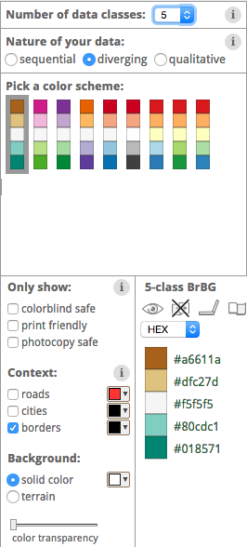
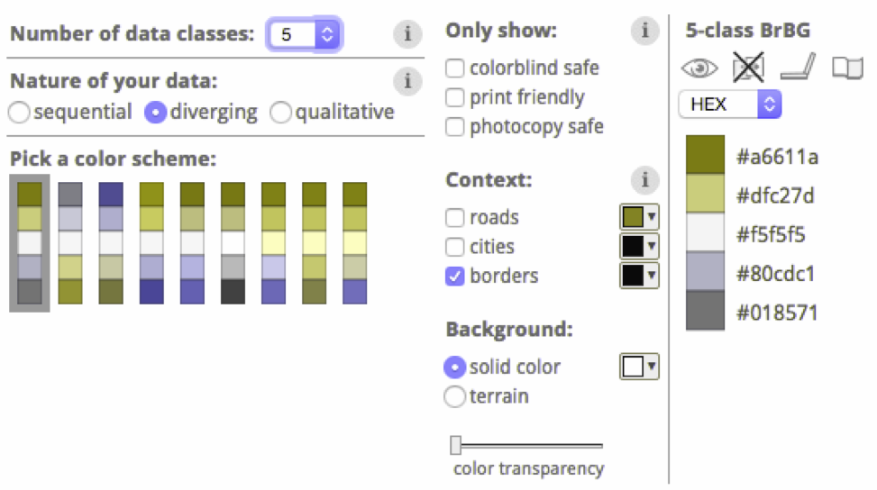
Make comparisons easy
Picking a colour scale using ColorBrewer 2.0
Colour resources
ColorBrewer 2.0 – helps you create colour palettes and notes whether they are colour-blind, print and photocopy friendly colorbrewer2.org
Color Oracle – a colour-blindness simulator that applies a filter to your screen to demonstrate how it would be perceived by people with several types of colour impaired vision colororacle.org
Simulating deuteranopia with Color Oracle
Notes:
Although the all of the colour scales seen using the Color Oracle deuteranopia simulator look quite different to how they appear to normal colour vision, for some of the scales it is still easy to distinguish the different values on the scale, while others are unusable to someone with this kind of colour deficient vision

Slide 30
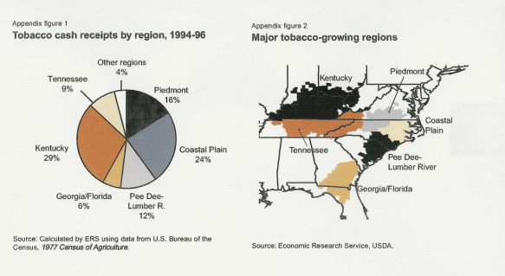
Avoid misleading presentation
Be consistent with colour and symbol choices
Tobacco and the Economy, Gale, Foreman, and Capehart, Agriculture Economic Report No. 789, September 2000.
Notes:
Using colours, patterns or symbols consistently in your figures not only helps to avoid confusion, but can also help readers to make connections in your data between figures. Note that if you have completely different sets, then reusing colours may not be a problem, as long as it is obvious that different things are being referred to. For example, if the pie chart in the figure on this slide were displaying the crops grown in a region, while the map continued to show the tobacco growing regions it would be quite obvious from figure titles and labels that completely different things were being displayed and the colours would not be likely to introduce confusion.

Slide 31
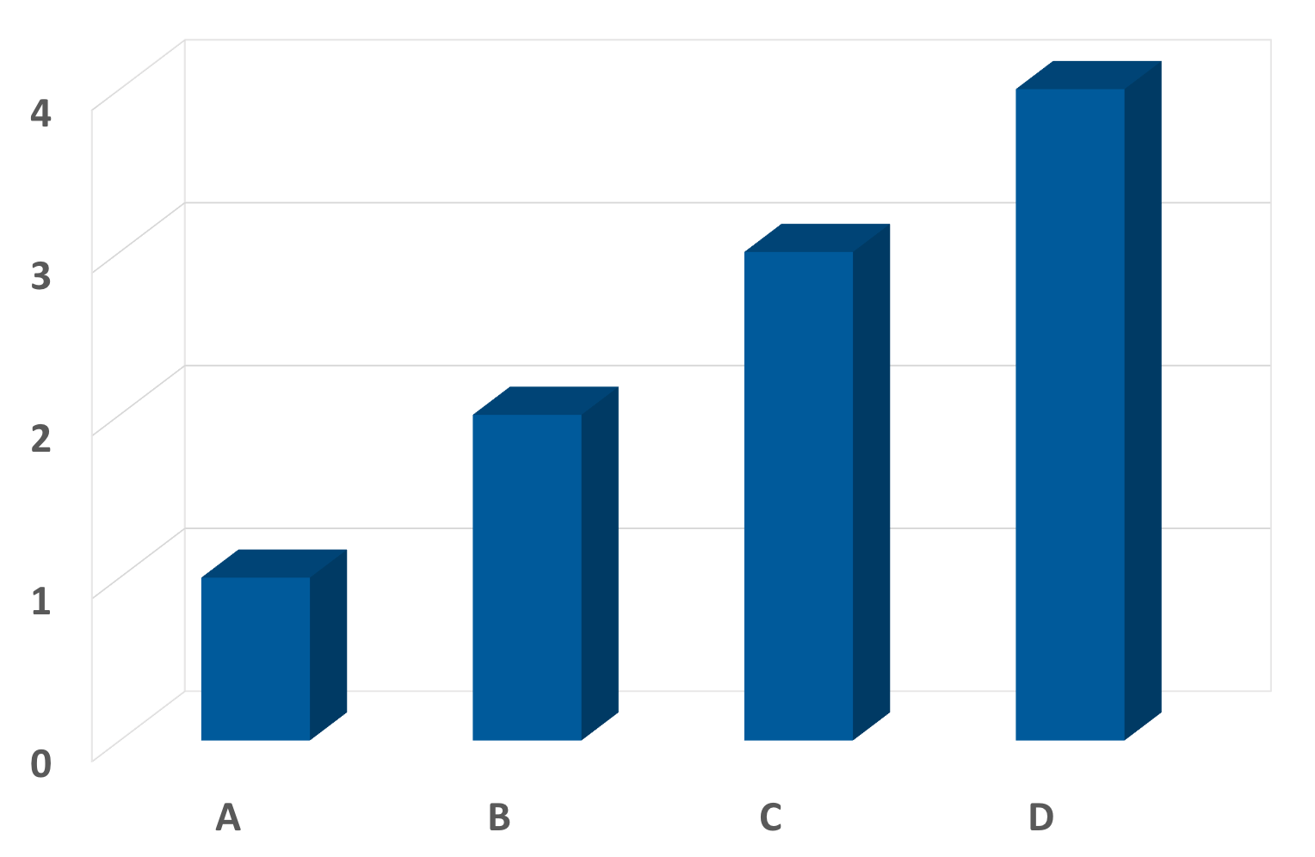
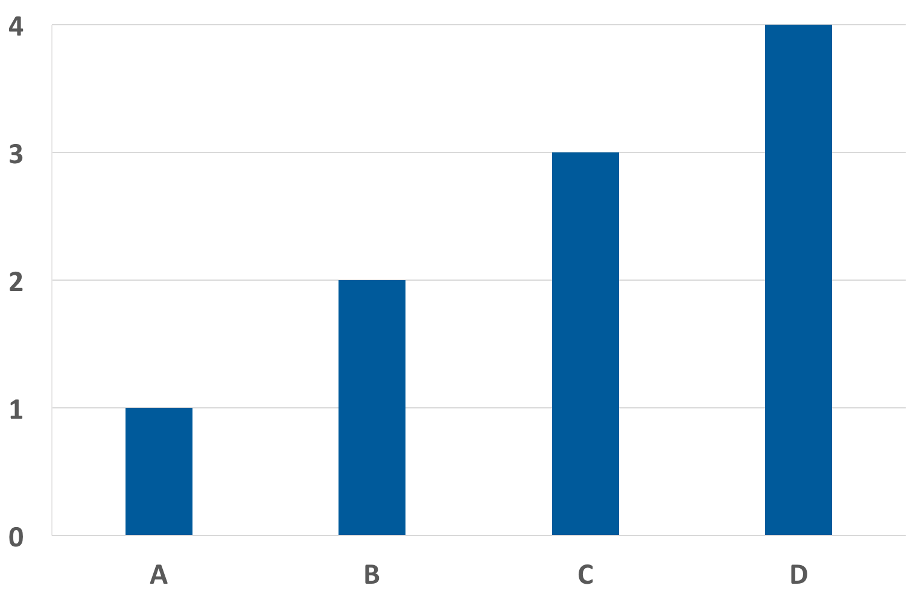
Avoid misleading presentation
Do not use pseudo-3D effects
3D effects for non-3D data distort your data
These bar plots were made using the exact same data!
Could you tell that the data values are 1, 2, 3, 4 for the pseudo 3D version?

Slide 32
So, to create an effective data visualisation…
Before you start, consider:
Who is it for?
How will it be presented?
What do you need to say?
Remember the Principles while making your visualisation…
Then get a pal to look it over.

Slide 33
Python example!
https://github.com/natbutter/SydneyTolls

Slide 34
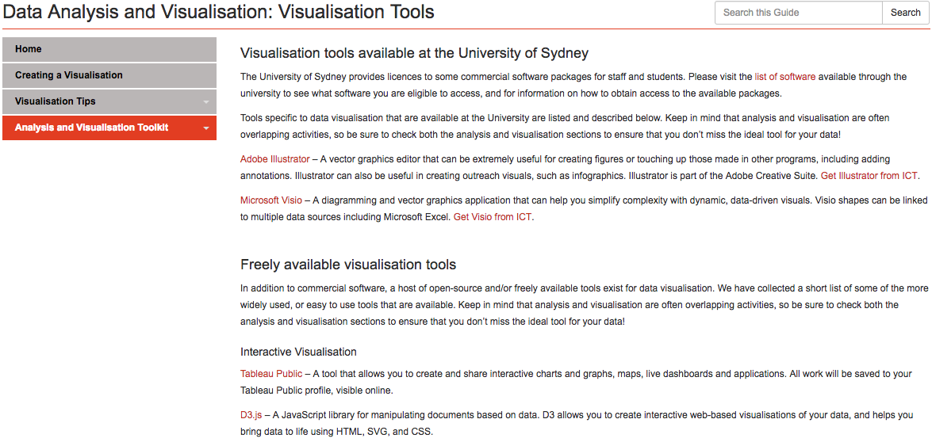
Where next?
Data Analysis and Visualisation Guide
http://libguides.library.usyd.edu.au/data-analysis-visualisation

Slide 35
Where next?
University training in specific tools, including Excel, MATLAB, R, Python
Training schedule available at:
https://informatics.sydney.edu.au/services/training/
Hacky Hour – A regular drop-in meetup for any questions about data, coding, analyses, visualisation, modelling, and research problems.
Consultations – come and talk to someone about your data, and what you want to visualise!
Email us: researchdatasupport@sydney.edu.au

Slide 36


Other Resources
The Noun Project and Flaticon
Libraries of icons free to use under Creative Commons licences
Bacteria by Adnen Kadri via the Noun Project [CC-BY 3.0 US]
family insurance by H Alberto Gongora via the Noun Project [CC-BY 3.0]

Slide 37
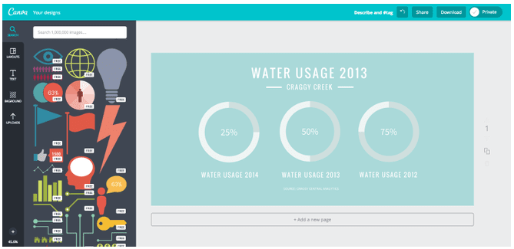
Other Resources
Canva
Browser-based graphic design tool
Includes a drag-and-drop infographic maker

Slide 38
Other Resources
Adobe Illustrator
Tidy up visualisations created with other tools
Make icons, infographics from scratch

Slide 39
Other Resources
Online training videos across a wealth of topics and tools, available to anyone with a UniKey
Access to LinkedIn Learning (formerly Lynda.com):
Go to https://www.linkedin.com/learning
Sign In with SSO
Login using your UniKey and password

Slide 40
References
Ahrens et al. (2012) Brain-wide neuronal dynamics during motor adaptation in zebrafish. Nature, 485(7399), 471-477. doi:10.1038/nature11057
Evergreen & Metzner (2013) Design principles for data visualisation in evaluation. In Azzam & Evergreen (Eds.) Data visualization, part 2. New Directions for Evaluation, 140, 5-20. doi:10.1002/ev.20071
Friendly (2001) Gallery of Data Visualization, Electronic document, accessed June 2016. http://www.datavis.ca/gallery/
Henderson & Segal (2013). Visualizing qualitative data in evaluation research. In Azzam & Evergreen (Eds.) Data visualization, part 1. New Directions for Evaluation, 139, 53-71. doi:10.1002/ev.20067
Maloney et al. (2011) Crustal growth during back-arc closure: Cretaceous exhumation history of Cordillera Darwin, southern Patagonia. Journal of Metamorphic Geology, 29(6), 649-672. doi:10.1111/j.1525-1314.2011.00934.x
McInerny & Krzywinski (2015) Points of View: Unentangling complex plots. Nature Methods, 12(7), 591. doi:10.1038/nmeth.3451
National Oceanic and Atmospheric Administration (NOAA), National Centers for Environmental Information, Electronic document, accessed July 2016. https://www.climate.gov/maps-data
Reese et al. (2012) Living kidney donation: outcomes, ethics, and uncertainty. The Lancet, 385(9981), 2003-2013. doi:10.1016/S0140-6736(14)62484-3
Rougier et al. (2014) Ten Simple Rules for Better Figures. PLoS Computational Biology, 10(9), e1003833. doi:10.1371/journal.pcbi.1003833
Tripto et al. (2013) Mapping What They Know: Concept Maps as an Effective Tool for Assessing Students’ Systems Thinking. American Journal of Operations Research, 3(1A), 245-258. doi:10.4236/ajor.2013.31A022
Tobacco and the Economy, Gale, Foreman, and Capehart, Agriculture Economic Report No. 789, September 2000.
U.S. Census Bureau, Census 2000 Redistricting Data (PL 94-171) Summary File. Available at http://www.census.gov/population/www/cen2000/atlas/index.html

